Slide 1
FAN BEAM CT
Submitted by
Anand P Kadumberi
Neethu Lekshmi
Sharmi Ravindran

Slide 2
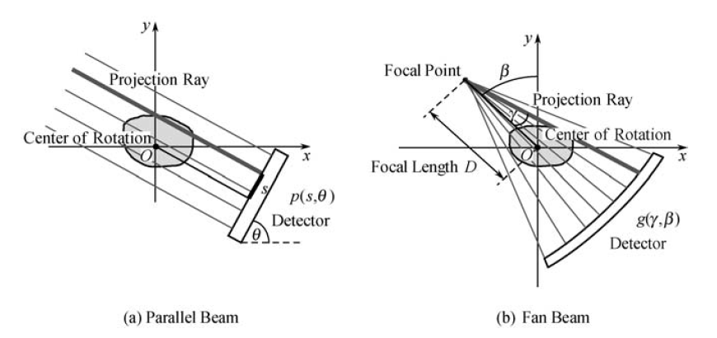
Projection Geometries
Single X-ray source and ring of detectors
Source rotates and projection is taken at each angle
The dark gray ray in both parallel and fan beam configurations are the same. Therefore occupy the same point in sinogram

Slide 3
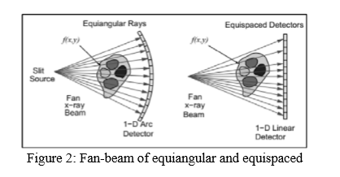
Types of Detectors

Slide 4
Evolution of CT Geometry
First Generation: Parallel Beam Geometry
Second Generation : Fan beam, Multiple Detectors
Third Generation: Fan beam, Rotating Detectors
Fourth Generation: Fan beam, Fixed Detectors
Fifth Generation: Scanning Electron beam
Current CT scanners uses third, fourth or fifth generation geometries.

Slide 5
Parallel vs Fan beam
Parallel beam | Fan beam
Relatively simple and straight forward | Interpolate fan beam projections into parallel beam projections
Employs large amount of radiation | Reduces scanning time
Expensive and not feasible | Currently used in field applications
Ring artifacts, significant noise and vibrations
Parallel beam uses simple reconstruction algorithm. | Fan beam are converted to parallel prior to image reconstruction
Acquisition time is higher, hence slower | Fan beam CT is much faster.
It is not cost efficient | It is economical and cost effective

Slide 6
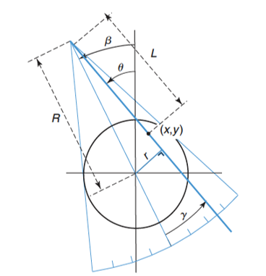
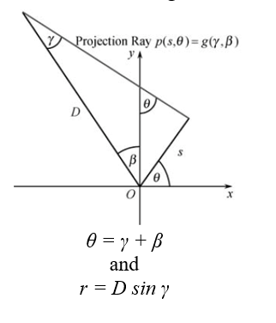
Principle of fan beam CT

Slide 7
Rebinning
p (r, θ) = g (γ, β)
r = x cos θ + y sin θ; s= - x sin θ + y cos θ
x = r cos θ - s sin θ; y = r sin θ + s cos θ
x=R cos ϕ; y=R sin ϕ;
p(r, θ) = ∫∫ δ(R, ϕ) δ(x cos θ+y sin θ- r) dx dy
r = R cos(θ -ϕ)
Applying the above rebinning conditions for fan beam CT,
g(D sin γ, γ +β) = ∫∫ δ(R, ϕ) δ(x cos (γ +β) +y sin (γ +β )- D sin γ) dx dy
r = R cos(γ + β -ϕ)

Slide 8
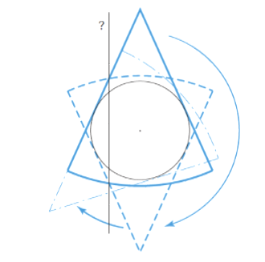
360 Degree Acquisition

Slide 9
Filtered back projection
b(x,y)= f(x,y) ⊗ 1/√x2 +y2
B(ωx, ωy)= F(ωx, ωy) ⊗ 1/√ωx² +ωy²
F(ω_{x}, ω_{y})= B(ω_{x}, ω_{y})⊗ |ω|
f(x,y)= IF[F(ω_{x}, ω_{y})]= IF[B(ω_{x}, ω_{y})⊗ |ω|]

Slide 10
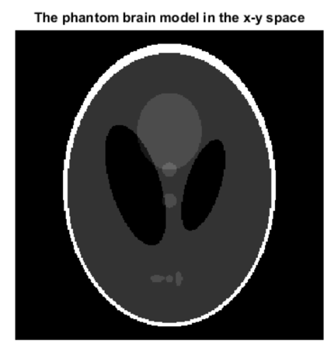
IMAGE RECONSTRUCTION USING MATLAB

Slide 11
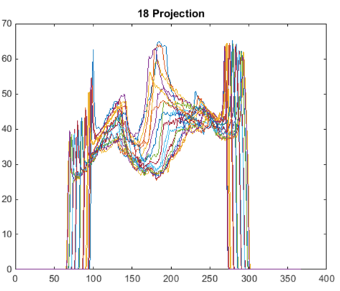
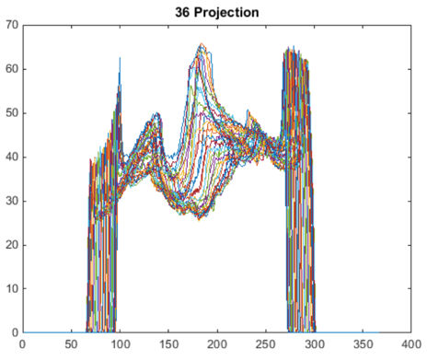
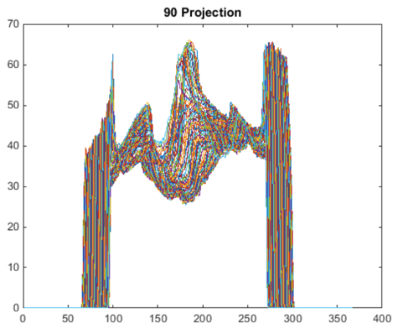
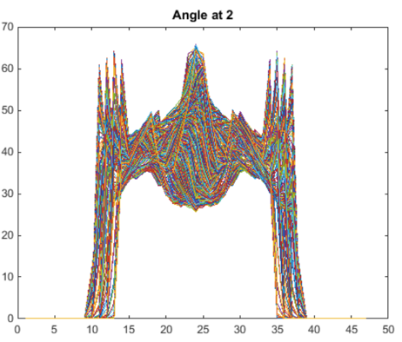
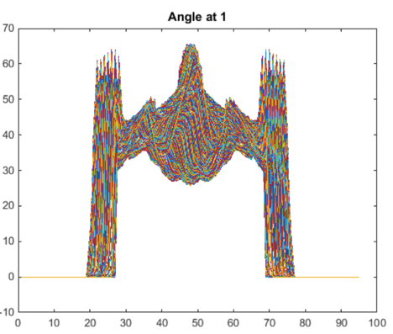
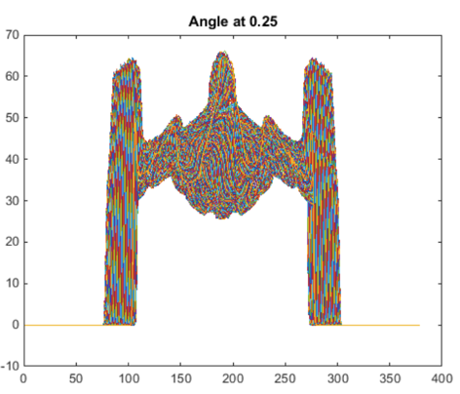
PROJECTIONS USING PARALLEL AND FAN BEAM GEOMETRY
‘Radon’
p(r,𝜃)
‘Fanbeam’
(‘Radon’ + ‘Para2fan’)
g(𝛾, β)
𝜃 = β + 𝛾
r = D sin 𝛾
Notes:
Projection can be taken from 0 to pi for parallel beam; but 0 to 360 + 2* fan angle for fan bean (full scan) 0 to 180 + 2*fan angle (short scan)

Slide 12
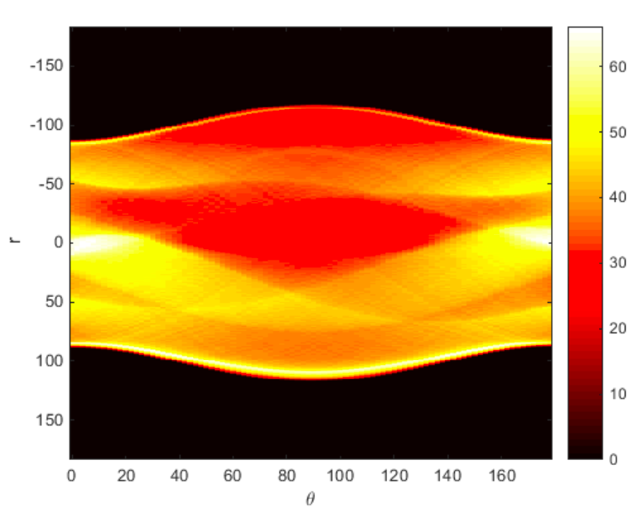
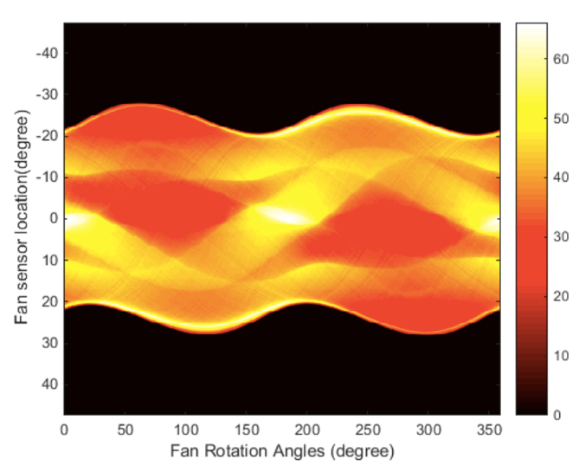
SINOGRAM OF PARALLEL AND FAN BEAM CT
r=R cos (𝜃 - ϕ)
D sin 𝛾 =R cos (β + 𝛾 - ϕ)

Slide 13
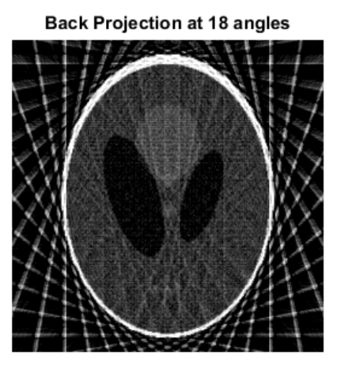
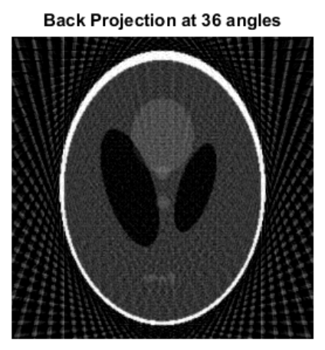
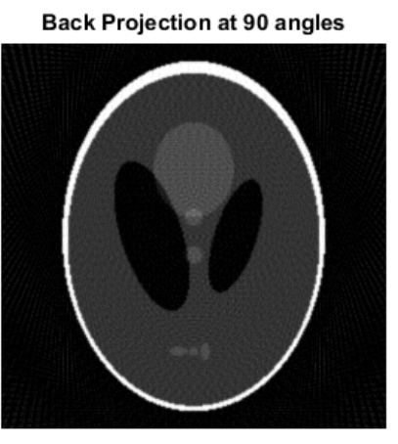
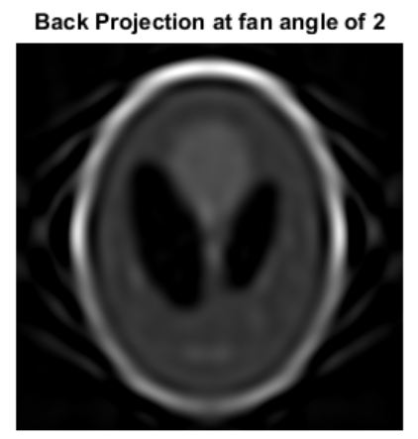
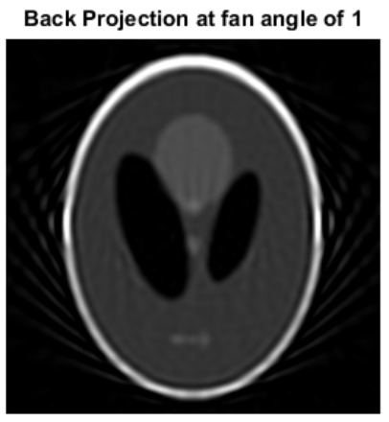
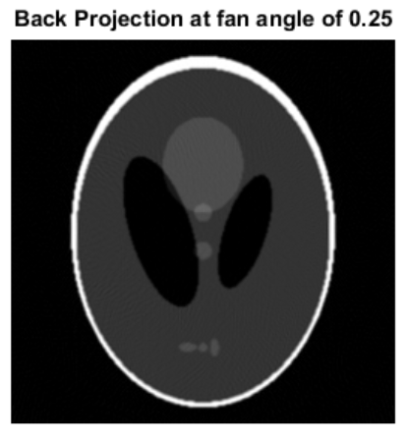
BACPROJECTION USING PARALLEL AND FAN BEAM ct
‘iRadon’
∫p(r,𝜃)d𝜃
‘iFanbeam’
(‘iRadon’ + ‘Fan2para’)
β + 𝛾 = 𝜃
D sin 𝛾 = r

Slide 14
References
[1] M.S.M. Yusoff, R. SulaimanImage Image reconstruction of computed tomography using fan-beam Technique (2012). J. Eng,CS&Tech 0105: 06 – 11.
Medical Image Reconstruction, Gengsheng Lawrence Zeng,Springer

